Slide 1
Strategic opening of a new Chinese Restaurant in Singapore

Slide 2
Singapore –its economy and ethnicity
Singapore has a highly developed market economy, based historically on extended entrepôt trade
Between 1965 and 1995, growth rates averaged around 6 per cent per annum, transforming the living standards of the population
Census reports that about 74.1% of residents were of Chinese descent
It makes sense to open a Chinese Restaurant in the booming market of Singapore

Slide 3
Factors to open a Restaurant
It becomes important to choose a location that :-
Targets as many customers as possible
Has a population base with adequate spending power
Has not too many competitors

Slide 4
Data Acquisition and Cleaning
Competitor data – Chinese restaurants already available in Singapore for each planning area – Combination of foursquare API + Planning area data of singapre as described in the following:
Singapore Planning areas / subzones location data:
https://en.wikipedia.org/wiki/Planning_Areas_of_Singapore
https://en.wikipedia.org/wiki/Postal_codes_in_Singapore
Latitude and Longitude data can be made by google searching the planning area name / Nominatim library of python
Geographical distribution , ethnic distribution and average monthly income data for Singapore
https://www.singstat.gov.sg/find-data/search-by-theme/population/geographic-distribution/latest-data
Total 28 Planning Areas were used for analysis

Slide 5
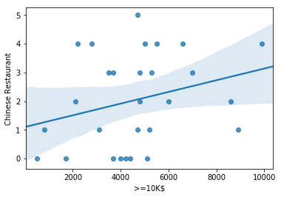
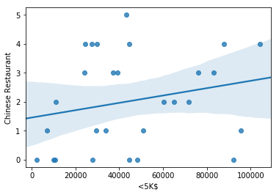
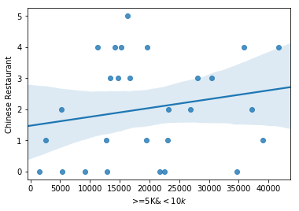
Relationship between Monthly income brackets and Chinese Restaurants

Slide 6
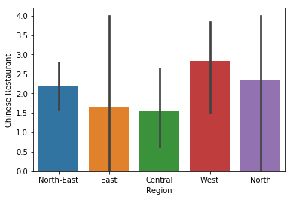
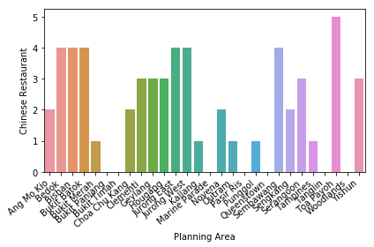
Relationship between Region, Planning Areas and Number of Chinese Restaurants

Slide 7
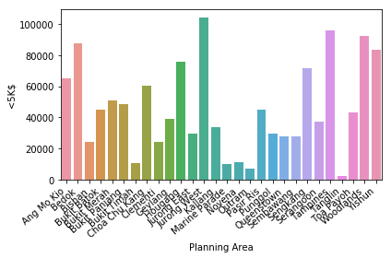
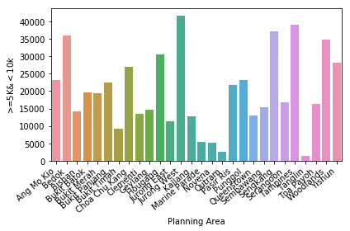
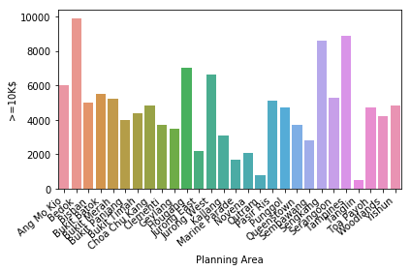
Population distribution by monthly income among planning areas

Slide 8
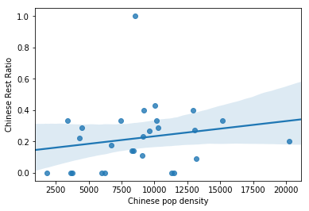
Impact of Chinese Population density on number of Chinese Restaurants

Slide 9
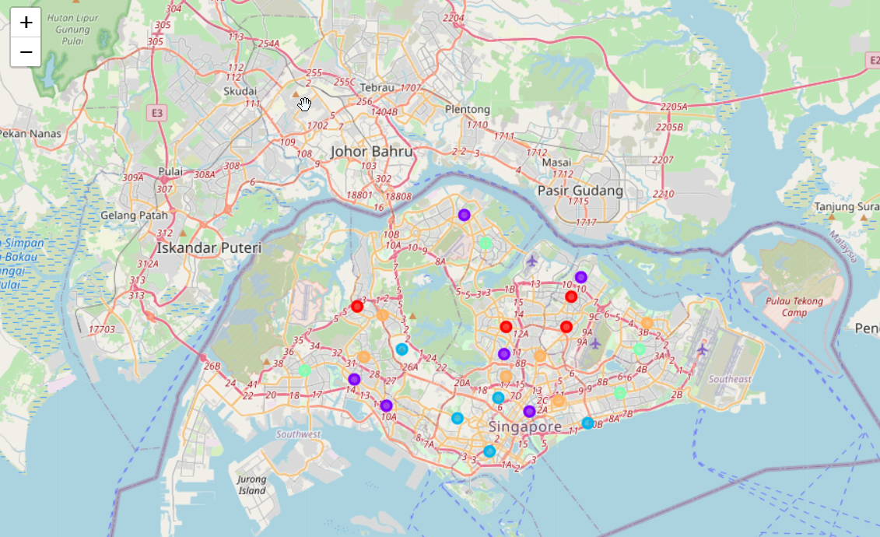
K- Means Clustering

Slide 10
Cluster 1
Most of the population lives under 5K$ (Low income)
20-30% of the restaurants are Chinese (High Competition)
10-15K Chinese population density (per Km2) (High Population Density)

Slide 11
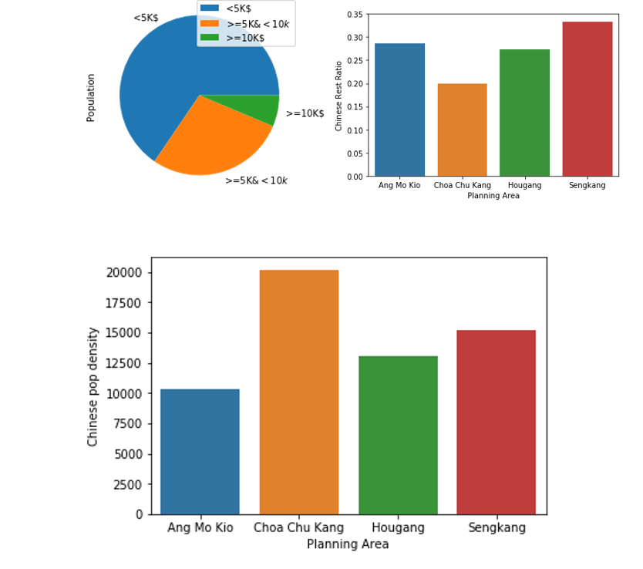
Cluster 1

Slide 12
Cluster 2
Significant people in income >=5K$ and >=10K$ (More than average income)
Most areas have >=25% of Chinese restaurants (High Competition) . However Queenstown has no Chinese restaurant
Average Chinese Population density is between 7K and 9K per Km2(Average Chinese pop density)

Slide 13
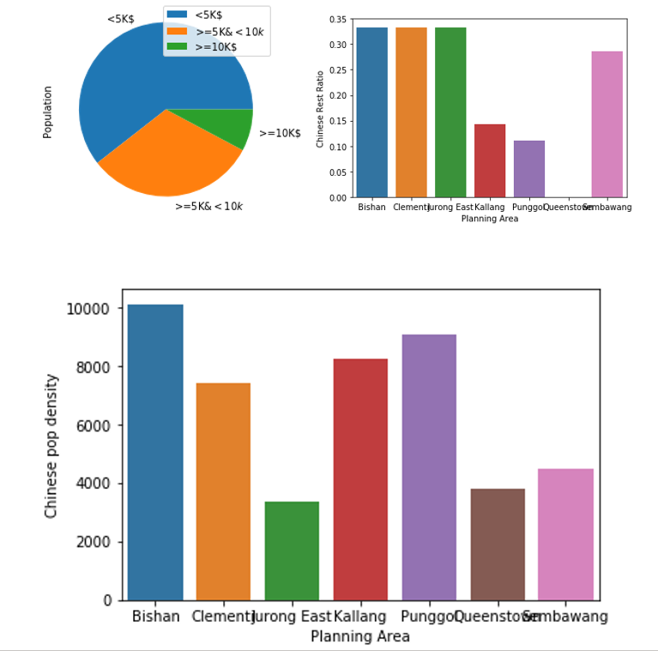
Cluster 2

Slide 14
Cluster 3
Significant people with income >=10K$ (High average income)
Most areas have no Chinese restaurants (Low Chinese restaurant Ratio)
Chinese Population density is pretty low (avg arnd 5K per Km2)
However Outram area has high Chinese population density and around 9% Chinese Restaurants

Slide 15
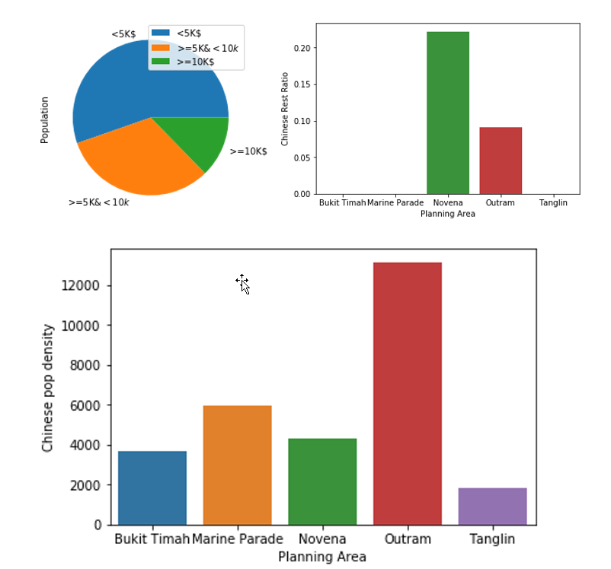
Cluster 3

Slide 16
Cluster 4
Significant Population in <5K$ and <10K $ (More than average income)
15% Chinese Restaurants on average (Moderate competition)
Chinese population density on average arnd 10K per Km2 (More than average Chinese population density)
Area Woodlands has no Chinese restaurant and pretty high Chinese population density(>10k)

Slide 17
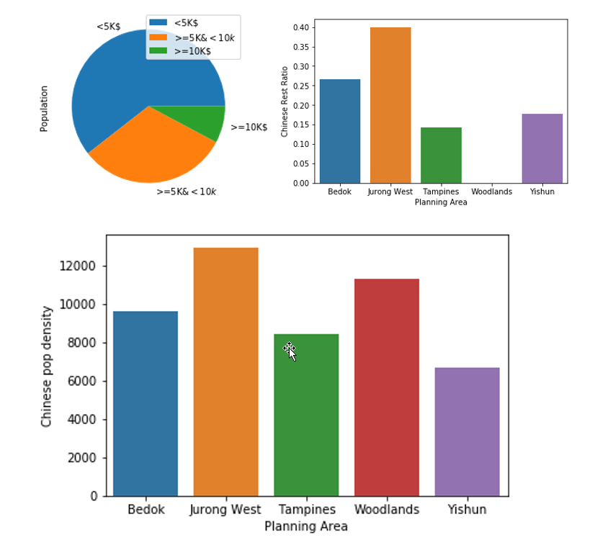
Cluster 4

Slide 18
Cluster 5
Most population under 5K$ (Low Average income)
>30 % restaurants are Chinese (High Competition)
Average Population Density (8-10K per Km2)

Slide 19
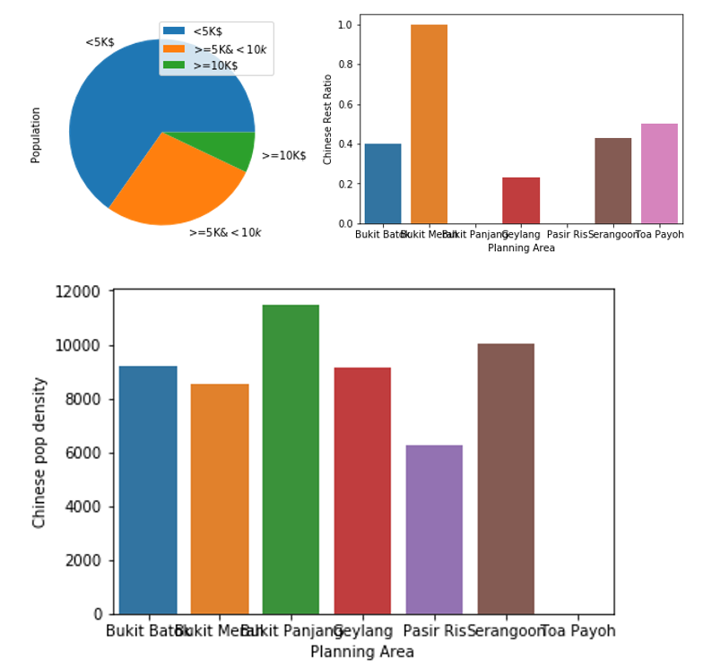
Cluster 5

Slide 20
Observations
Areas in Cluster 1 have high Chinese population density and low average monthly income with high competition . This could be suitable for restaurants with under budget menus and not very expensive ones
Areas in Cluster 2 have pretty high income and high competition , however Queenstown is an area where there is no Chinese Restaurant hence could be targeted
Areas in Cluster 3 have very low Chinese Restaurant competition and more than avg income population . Outram is an area with high Chinese population density and could be suitable for the location
Areas in Cluster 4 have more than average income and moderate competition . Woodlands is an area with no Chinese restaurant .
Areas in cluster 5 have high competition , low average income and moderately high Chinese population density . It may not be suitable to open a restaurant here .

Slide 21
Conclusions and Future Direction
The above analysis was fairly able to identify areas based on the data where it would be optimal to open a Chinese Restaurant and where it would be not
The analysis however does not yet include the cost of living , cost of procurement and other factors that a restaurant has to deal with on a day to day basis due to time constraints . The solution however can be extended to include that analysis
The analysis can also be extended to existing Restaurant chains who want to open a restaurant at a new location

